Slide 1
Bioeconomy Lesson Plan for Multipliers
M. Giannakopoulou

Slide 2
Table of Contents
01
Lesson Objectives
04
Bioeconomy – Definition & Examples
02
Materials Needed
05
The Benefits of Bioeconomy
03
Introduction
06
Pretend you are a bio-resource or a bio - product.
KWL Chart

Slide 3
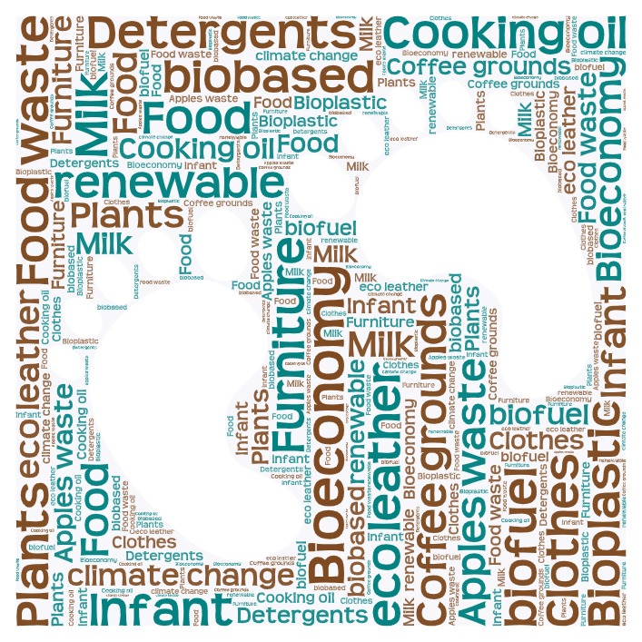
Lesson Objectives
Teaching session 1
Teaching Session 1
Teaching Session 2
Participants will develop an understanding of the concept of bioeconomy, its importance, and its potential applications. More specifically:
You can watch the video to learn more about the lesson plan objectives
https://lumen5.com/user/marianthikgiannakopoulou/untitled-video-ud0ip/
participants will engage in interactive discussions and activities aiming at exploring the applications of bioeconomy in their lives.
participants will be trained in using the 7-step Eco schools approach into problem solving and they will disseminate their knowledge on bioeconomy to a larger community.
participants will explore the challenges and benefits of bioeconomy
Notes:
The teacher can show the participants the video with the lesson objectives to introduce them to the sessions.

Slide 4
Materials needed
Whiteboard/Flipchart and markers
Handouts or access to online resources on bioeconomy
Case studies or examples of bioeconomy applications
Post-it notes
Pens/pencils
Powerpoint presentation
Handouts (assessment, exit ticket, questionaire etc)

Slide 5
Session 1
Bioeconomy Concept

Slide 6
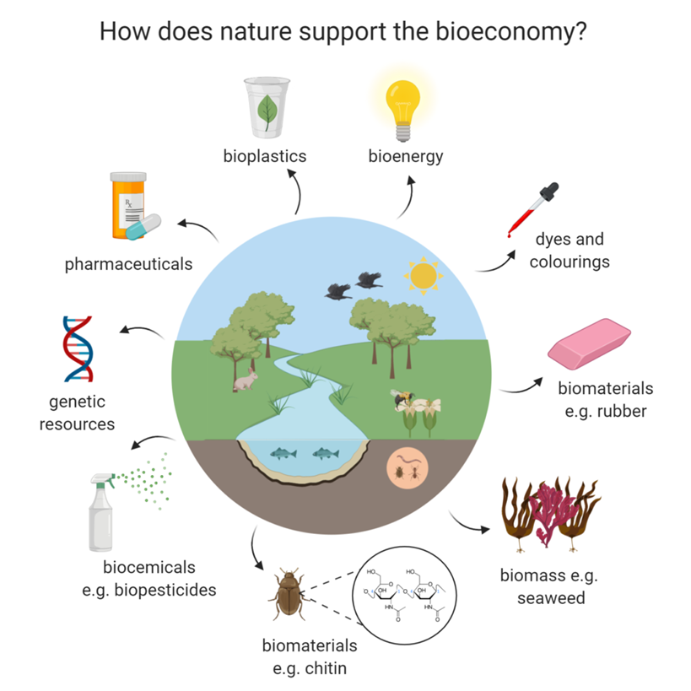
What is Bioeconomy?
https://lumen5.com/user/marianthikgiannakopoulou/what-is-bioeconomy-z3eqf/
European Commission: The bioeconomy means using renewable biological resources from land and sea, like crops, forests, fish, animals and micro-organisms to produce food, materials and energy.
Notes:
Introduction - Warm-Up Activity (5 minutes):
1. The teacher shows the students a video related to Bioeconomy in our daily life. Then they look at the picture and read an excerpt about the topic. Finally, a discussion follows and they all write down their definition of bioeconomy on a post-it note which they keep on their desks.

Slide 7
Walk around- Find your pair
Participants will delve into the key components of bioeconomy through a questionnaire -cards with questions and answers.
Notes:
The teacher explains that they will play a game to get to know each other but also some more info about bioeconomy and then he give each participant a clue card. The teachers adds that some participants have the question cards and some of them have the answer cards . The participants will have to stand up and start moving around. They tell their name and read the question or answer and they will try and pair up with “their other half”. After the matching is done, they all read aloud the questions and answer and they revisit their definition. Do they have anything to change, add or omit? Finally the stick the post-it notes on the Bioeconomy poster on the Flipchart.

Slide 8
Notes:
Participants engage in a discussion on some clue cards regarding the benefits of bioeconomy (e.g., reduced greenhouse gas emissions, job creation, resource efficiency) and the challenges (e.g., competition with food production, land-use conflicts, technological barriers) Divide participants into smaller groups and give out post-it notes. Then, ask each group to make a list of the benefits and challenges related to bioeconomy. Then, each group shares their findings with the rest of the participants and they discuss as a whole class. They add the post-it notes with benefits and challenges under their definitions.

Slide 9
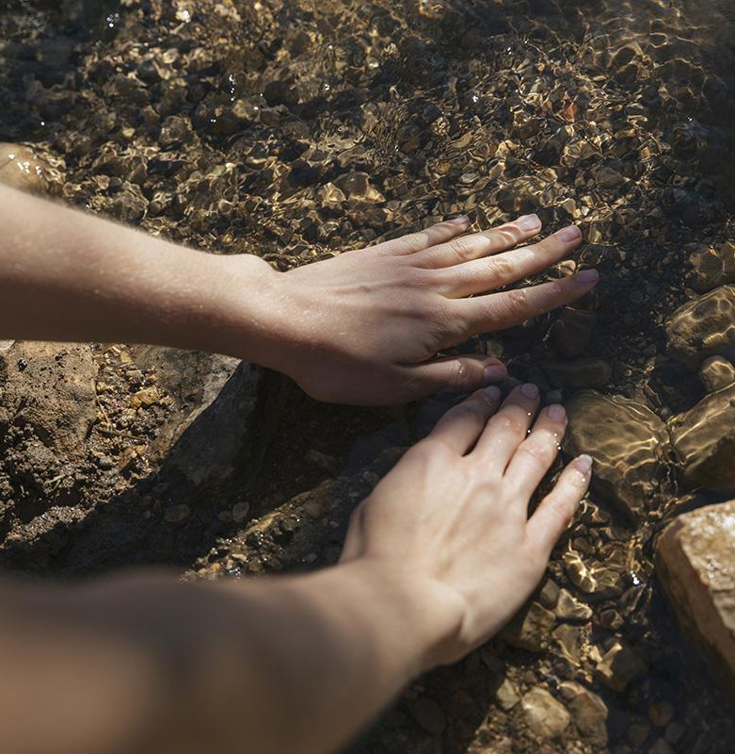
Why Bioeconomy? Successful examples of bioeconomy applications from countries all around the world.
https://www.fao.org/in-action/sustainable-and-circular-bioeconomy/resources/news/details/en/c/1329389/
Notes:
The teacher shares successful examples of bioeconomy applications from countries all around the world.

Slide 10
Homework – Be a Young Reporter for the Environment - Project
Pretend you are a young reporter for the environment. Can you create a video or write an article about one of the benefits of bioeconomy of your choice?
Notes:
Homework: Ask the participants to pretend they are young reporters for the environment who have to create their own videos to showcase how they use one of the biobased materials to make a biobased product. Encourage them to use their imagination and be informative and creative!

Slide 11
Project - Step by Step Instructions for the participants
Stage 01
Think or draw a picture of a renewable biological resource
or a bio-product we get from it. Alternatively, you can use visuals /pictures from the Internet
Stage 02
Explain how this bio-resource or product is used. You can pretend you are Young Reporters for the Environment and you present it to the public.
Stage 03
Use AI tools or diital application to make your video have an impact on young people.. or write a short article
Present your video/read your article to the rest of the participants.
Notes:
The teacher asks the students to draw a renewable biological resource or a bio-product we get from it. Alternatively, the teacher can give them visuals /pictures of resources and products
Project: Pretend you are a bio-resource or a product. Follow the model text and write a few sentences to introduce yourself to your classmates.
Then use the application Chatterpix Kids to make your picture speak. (link to the sample)
Present your video to your classmates.

Slide 12
Session 2
Eco Schools & Bioeconomy

Slide 13
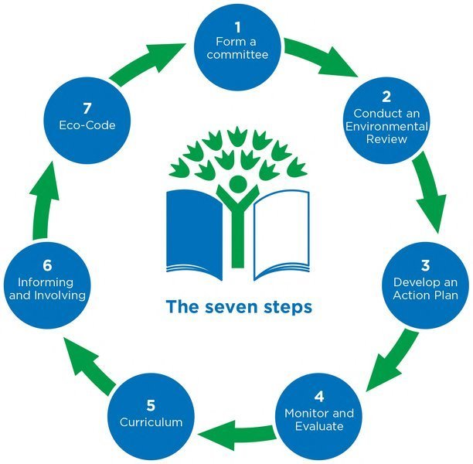
Eco schools & the 7-step methodology
Can you find the connections between the first session and the seven steps of ECO Schools?
Eco Code: https://www.youtube.com/watch?v=zRKxT70rkxI
Informing and Involving: https://www.youtube.com/watch?v=ZZPe0e8hJ00
Notes:
The teacher introduces the topic of the day, namely the 7-step methodology of ECO Schools. S/he explains that the students will try to use specific steps of the 7-step circle to disseminate the knowledge they acquired through session 1 related to the concept of Bioeconomy.The teacher uses a video (link) and the handout on Eco schools to introduce them to the students.

Slide 14
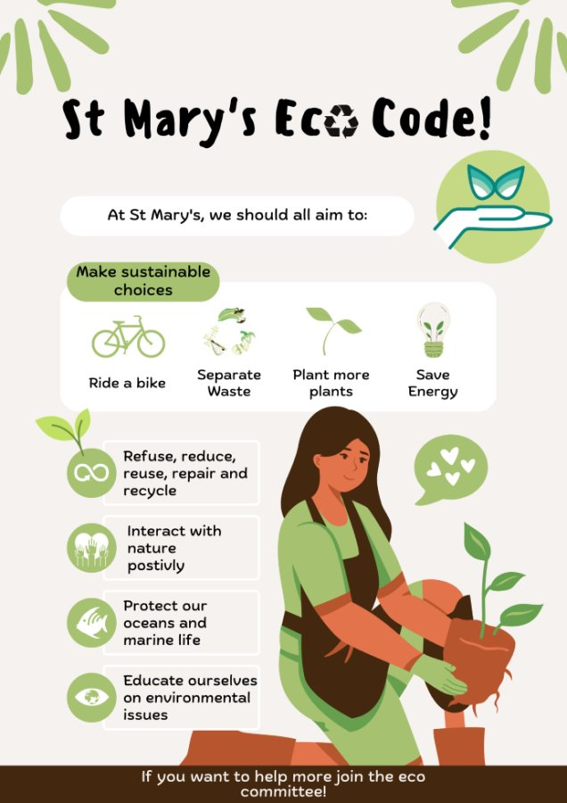
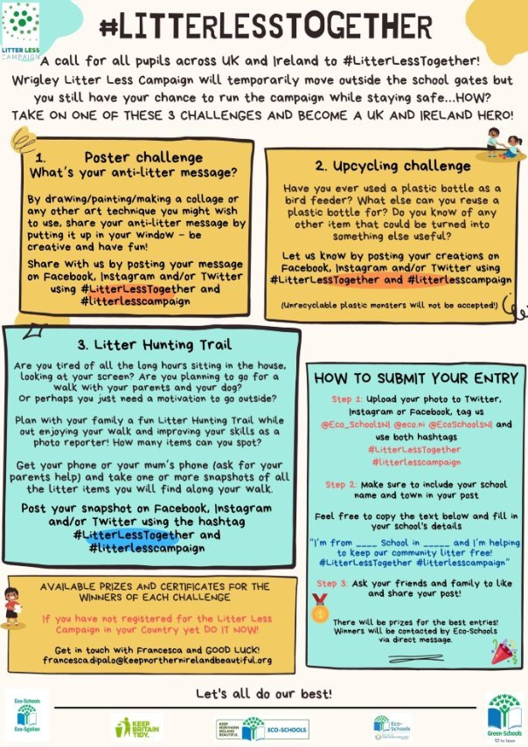
Brainstorm
How can we disseminate the results of our research on bioeconomy?
Should we use the videos we created?
How can we take action?
Let’s vote on the best ideas and delegate roles and responsibilities.
e.g We can show our videos in a youTube channel we can create about Bioeconomy
e.g We can organize a street campaign at a Univeristy campus or at a shopping mall and inform the general public about biobased products. They can also sign our ECO CODE on bioeconomy.
Resources for this activity:
https://www.bioeconomy-library.eu/wp-content/uploads/2019/11/2016_Biostep_Bioeconomy_Glasgow_Scotland.pdf
https://stateofgreen.com/en/news/five-examples-of-the-circular-bioeconomy-in-practice/
https://gbs2020.net/wp-content/uploads/2021/10/GBS2015_06_Product-Exhibition.pdf
Notes:
The teacher explains that the focus of the session will be on two steps, the Dissemination Stage and the creation of an ECO-CODE. The students watch the viseos and work in teams and brainstorm on the ways they can use to disseminate their knowledge using the videos they created. They also propose ways the whole school can use to take action. They vote on the best ideas and write them down. They delegate roles and responsibilities. (Brainstorm map) The participants can organize a campaign to inform the general public (or the students at a University, their peers etc)about the benefits and challenges of using Bioeconomy and encourage them to use biobased products.
Resources for this activity:
https://www.bioeconomy-library.eu/wp-content/uploads/2019/11/2016_Biostep_Bioeconomy_Glasgow_Scotland.pdf
https://stateofgreen.com/en/news/five-examples-of-the-circular-bioeconomy-in-practice/
https://gbs2020.net/wp-content/uploads/2021/10/GBS2015_06_Product-Exhibition.pdf

Slide 15
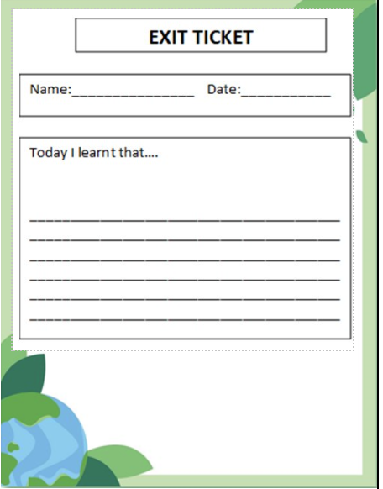
ASSESSMENT AND REFLECTION
Ask the participants to reflect on what they learnt during the lesson. Encourage them to complete the multiple choice activity. (quantitative)
The participants write an exit ticket to show the benefits of Bioeconomy in their everyday life. (qualitative)
Notes:
The teacher asks the participants to reflect on what they learnt during the lesson. S/he encourages them to fill in the multiple choice activity. (quantitative)
The teacher asks the participam to write an exit ticket as they leave the class answering the question “What are the benefits of bioeconomy in your everyday life?” or “Write the most impressive thing you learnt about bioeconomy” .

Slide 16
REFLECTION – If I were to do the Bioeconomy Project again…
Reflection for participants
Reflection for Teachers
Notes:
The students reflect on the 7-step methodology and the process they followed by answering the question “If you were to do the Bioeconomy project again, what would you keep and what would you leave out?” filling out the “Three checks – One cross” handout with three things they would like to experience again and one that was not particularly interesting or helpful. The lesson ends by emphasizing the role of individuals and communities in building a healthier planet.
The teachers also fill in the “Three Checks and a Cross” handout by answering the question “Choose two things you enjoyed and feel confident teaching again and one that was too difficult to teach or not particularly interesting or helpful.

Slide 17
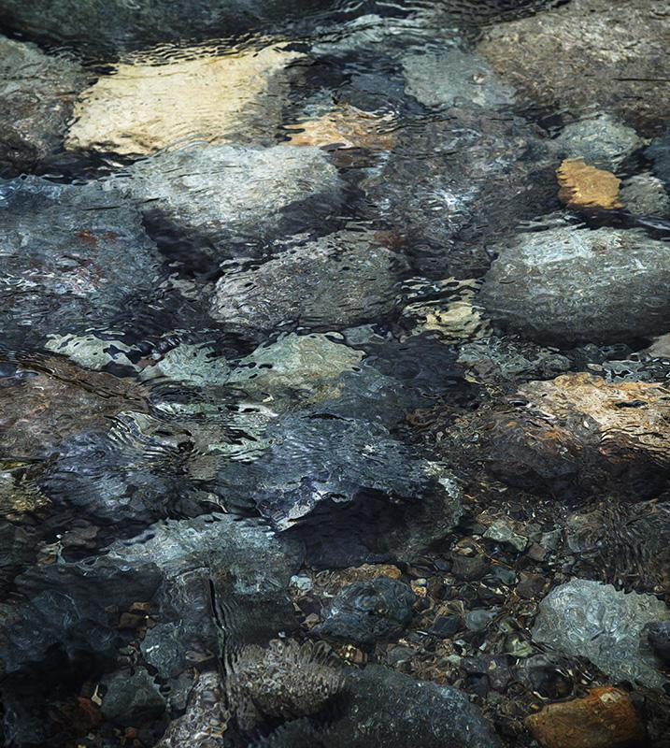
Thanks!
Do you have any questions?
Contact us in:
[insert your e-mail here]​ [insert your school/organization here]
Please keep this slide for the attribution

