Slide 1
Bioeconomy Lesson Plan Elementary School
M. Giannakopoulou

Slide 2
Table of Contents
01
About the Project
04
Bioeconomy – Definition & Examples
02
Pictures / Visuals of every day things
05
The Benefits of Bioeconomy
03
Materials used in bioeconomy
06
Pretend you are a bio-resource or a bio - product.
KWL Chart

Slide 3
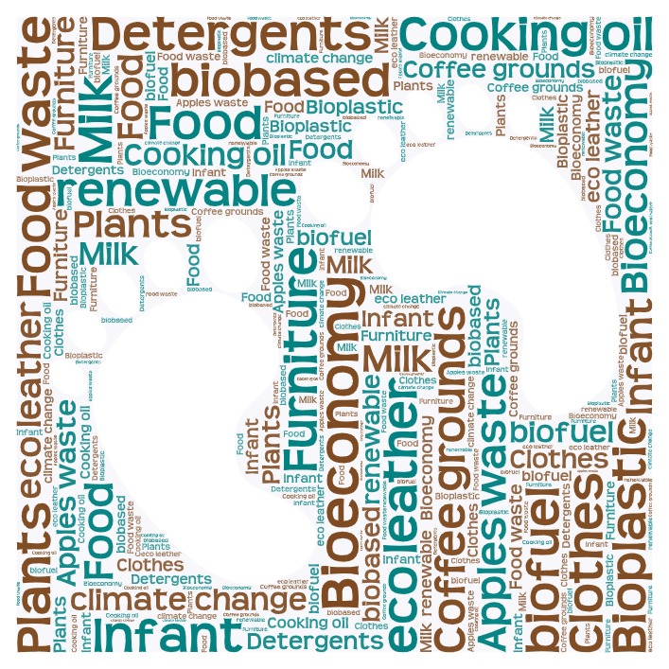
Lesson Objectives
Teaching session 1
Teaching Session 1
Teaching Session 2
students will brainstorm ideas for sustainable practices in their own lives, learn about eco schools and the 7-step methodology and use it to disseminate their ideas to the school community.
students will understand the concepts of bioeconomy and renewable biological resources.
students will realize how plants and natural materials can be used in the creation of products we use every day.

Slide 4
Materials needed
Whiteboard and markers or chalkboard and chalk
Projector and screen (if available)
Pictures or samples of renewable biological resources (e.g., plants, wood, cotton)
Printed/online materials or visual aids about bioeconomy and eco schools
Handouts with simple explanations and illustrations of bioeconomy concepts
Drawing / coloring/ craft materials (paper, pencils, crayons)
Small plants or pictures of plants
Chatterpix kids application
Powerpoint presentation of the lesson
Worksheets (writing, assessment, exit ticket)

Slide 5
Session 1
Bioeconomy Concept and applications

Slide 6
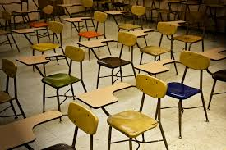
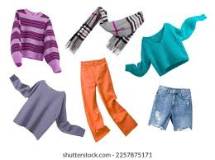
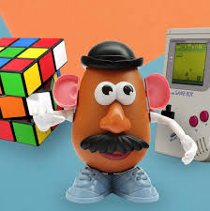
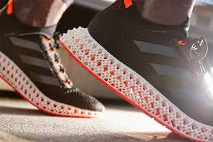
Objects & Materials we use every day
Pencil - Wood
Clothes - fabric
Toothbrush - Plastic
Desks - wood
Toys - Plastic
Phone Case - Plastic
Shoes – foam / fabric
Notes:
Introduction - Warm-Up Activity (5 minutes):
1. Show the students the pictures of things we use every day. Ask them if they know where the things come from. Encourage them to think about other materials around them (their clothes, school supplies, and food).

Slide 7
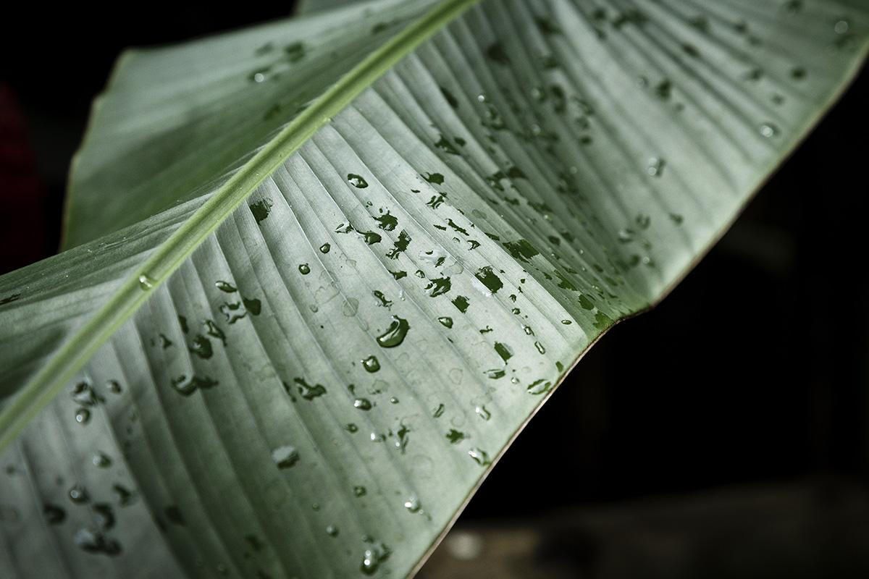
Are these the only materials we can use?
Think of material in nature that can be used to make objects you use every day.
Fill in the two columns of the KWL chart (Know – Want to Know).
Notes:
The teacher explains how we use materials from nature to make products . For example, we can use some fruit peels to make color pigments (add picture). Then he splits the class in groups and asks them if they can you think of any other materials we find in nature and we use to make new products? The groups write their answers on post –it notes and stick them on the board for everyone to see.

Slide 8
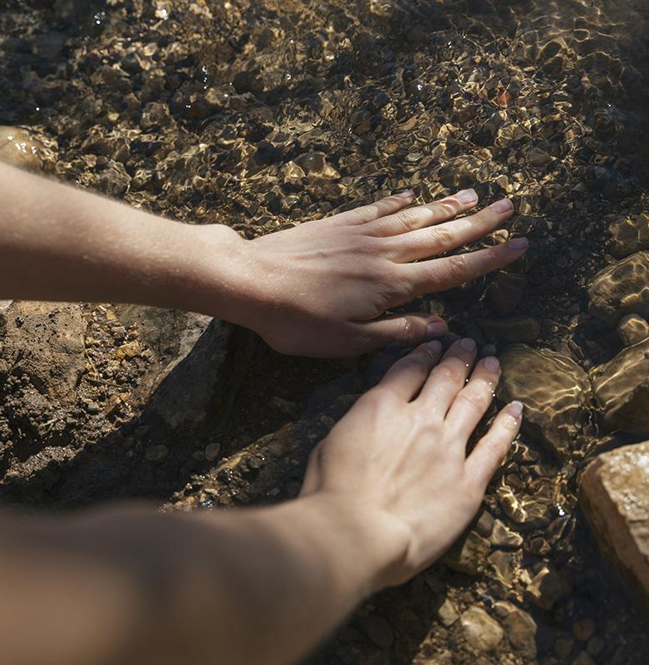
Brainstorm
Think about the things we use every day at home and at school.
What are they made of?
What material do we need?
Notes:
The teachers asks the students Think about the things we use every day at home and at school.
What are they made of?
What material do we need?

Slide 9
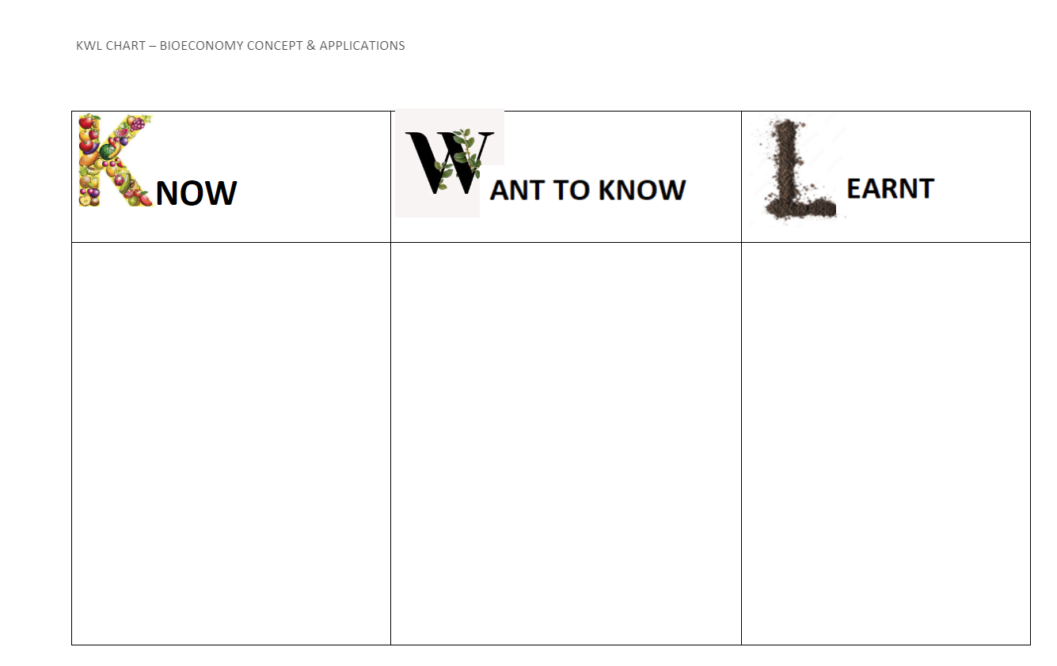
Notes:
After the 5 min introduction and discussion the teacher asks the students to fill in the first and second column of a KWL chart (Know-Want to Know- Learnt). What are the things I already know about “Bioeconomy” and what questions are raised after this brief introduction. In other words what do I want to learn about this new concept?

Slide 10
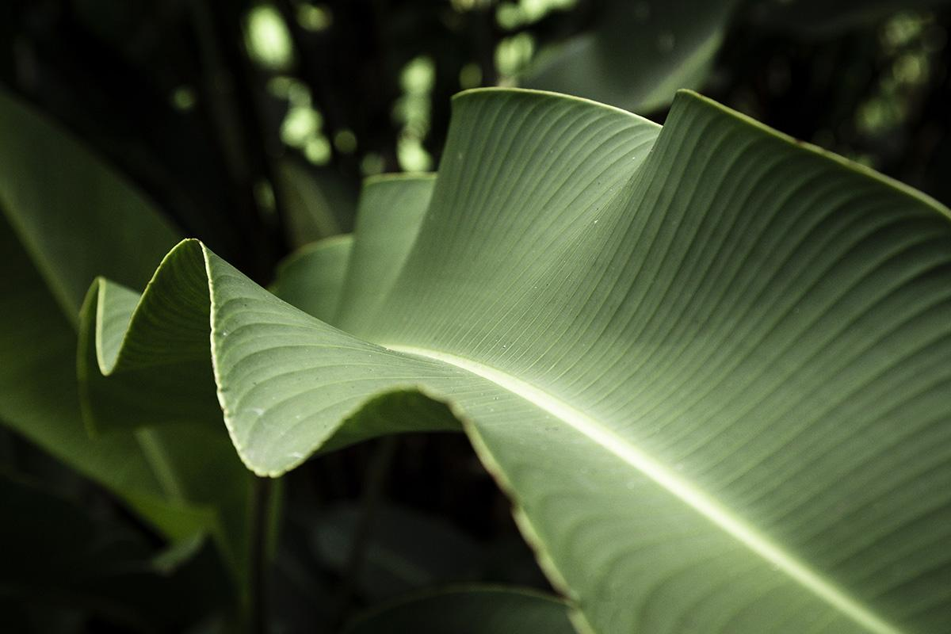
What is Bioeconomy?
Let’s watch the following video and talk about the concept of Bioeconomy.
https://www.youtube.com/watch?v=KYvJCIGxPLk
Notes:
The teacher introduces the term "bioeconomy" through the short video (https://www.youtube.com/watch?v=KYvJCIGxPLk) and explains that it it involves using renewable biological resources (like plants and animals) to create products and services.
Then the students are asked to come up with a definition as a group (the same groups that worked on the KWL Charts)

Slide 11
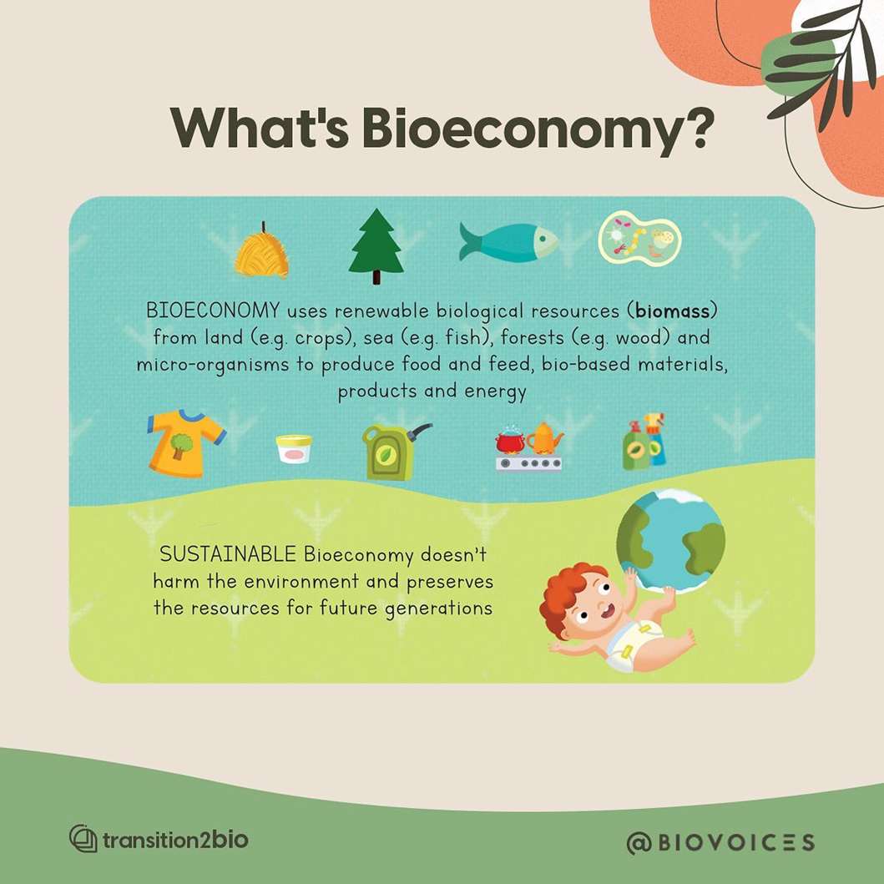
Notes:
The teachers show the students examples or pictures of renewable biological resources, such as plants, wood, and cotton and their applications in modern life. The students are asked to look at the their definition and highlight any of the words presented on this slide that is also included in their definition.

Slide 12
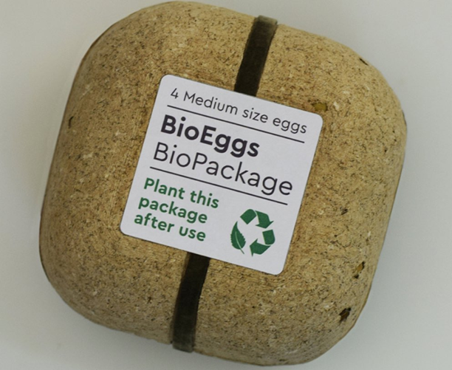
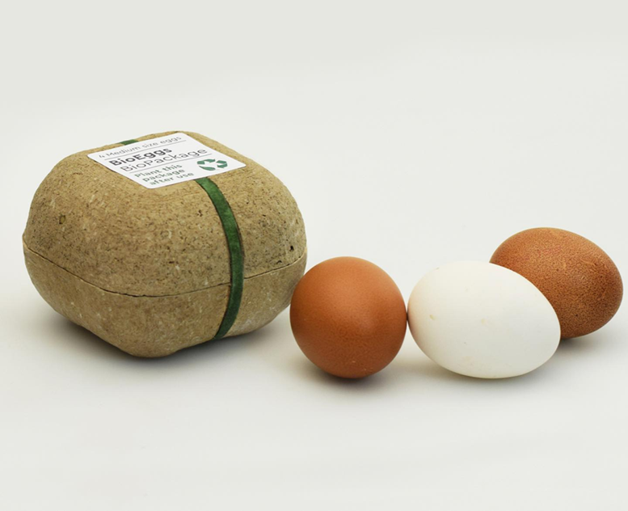
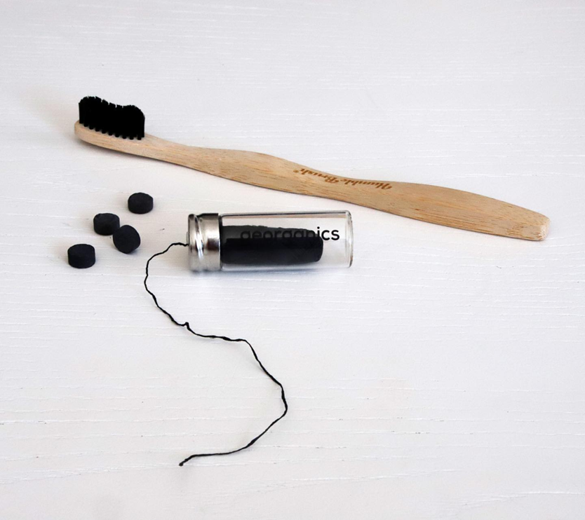
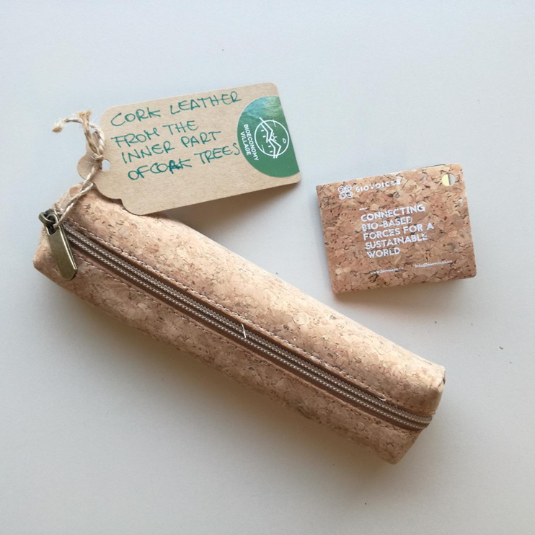
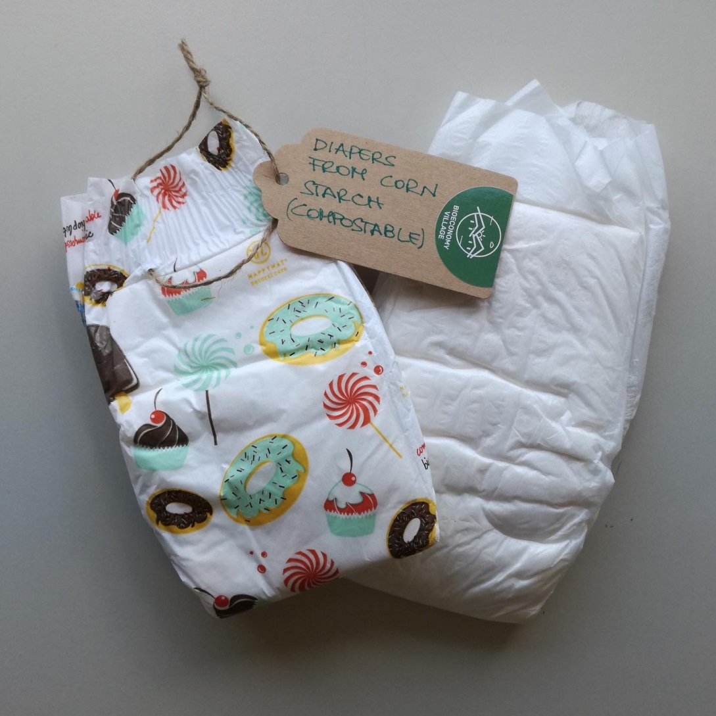
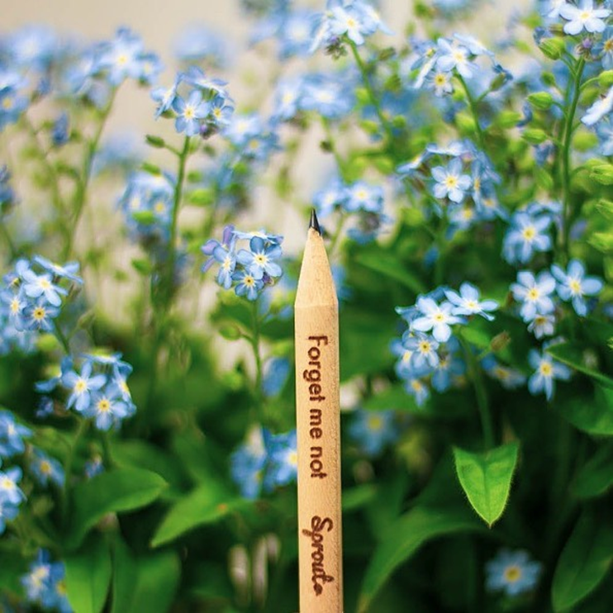
BIO-BASED PRODUCTS
Notes:
The teacher shows examples or pictures of renewable biological resources, such as plants, wood, and cotton and their bio-based products. In the pictures, the students can see diapers made of corn starch, Cork leather made of the inner part of cork trees, an organic egg package (make a handout with these pictures). S/He asks the students if they have ever seen or used any of these products. You need to add the rest.

Slide 13
Renewable biological resources
Notes:
The teachers shows the students examples of more bio-based products and explains the stages of turning the poo into a notebook.

Slide 14
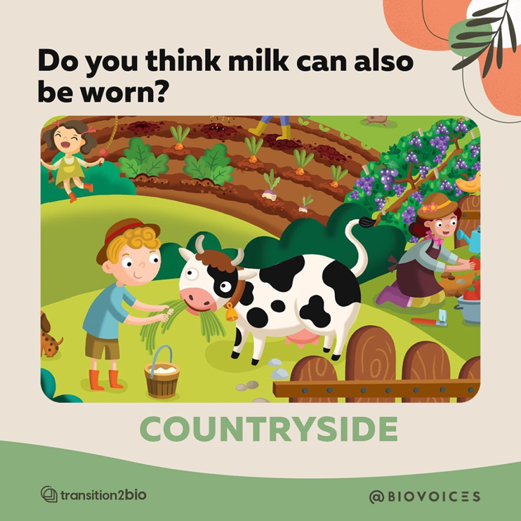
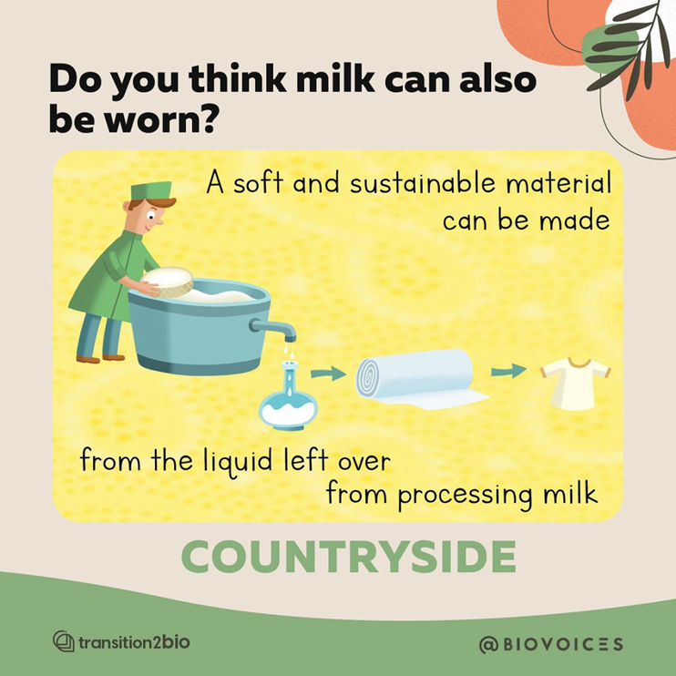
Renewable biological resources
Notes:
The teachers asks the students if they can wear something made of milk and explains how a soft and sustainable material can be made from the liquid left over from processing milk.

Slide 15
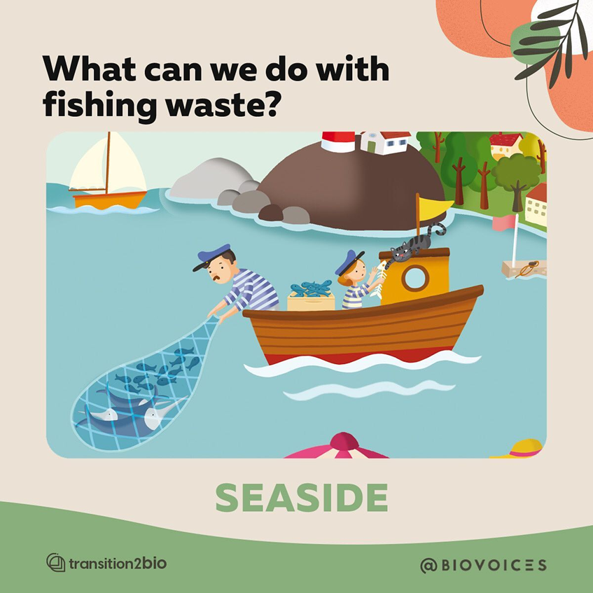
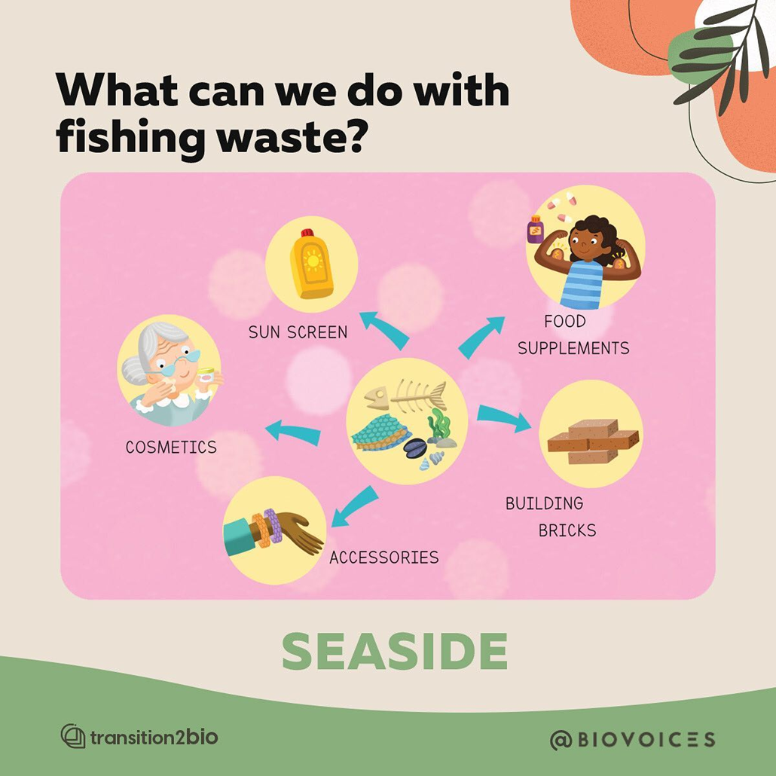
Notes:
The teachers asks the students if they have ever thought that we can use fishing waste to make something new. The s/he explains that if we process fishing waste we can produce cosmetics, accessories, building bricks, food supplements and sunscreen.

Slide 16
QUIZ TIME TRASH OR TREASURE?
Trash or Treasure? | Product or Use
Corn starch | Accessories
Fishing waste | Clothes
Animal Poo | Paper
Milk leftover | Cork leather
Inner part of trees | Diapers
https://wordart.com/create
Notes:
The teacher checks the students’ understanding through this “Trash or Treasure” matching activity / assessment

Slide 17
Project
Pretend you are a bio-resource or a bio-product. Follow the model text and write a few sentences to introduce yourself to your classmates.”

Slide 18
Project - Step by Step Instructions for Students
Stage 01
Draw a picture of a renewable biological resource
or a bio-product we get from it. Alternatively, you can use visuals /pictures provided in the handout.
Stage 02
Pretend you are this bio-resource or a product. Follow the model text and write a few sentences to introduce yourself to your classmates.
.
Stage 03
Use the application Chatterpix Kids to make your picture speak.
Present your video to your classmates.
Notes:
The teacher asks the students to draw a renewable biological resource or a bio-product we get from it. Alternatively, the teacher can give them visuals /pictures of resources and products
Project: Pretend you are a bio-resource or a product. Follow the model text and write a few sentences to introduce yourself to your classmates.
Then use the application Chatterpix Kids to make your picture speak. (link to the sample)
Present your video to your classmates.

Slide 19
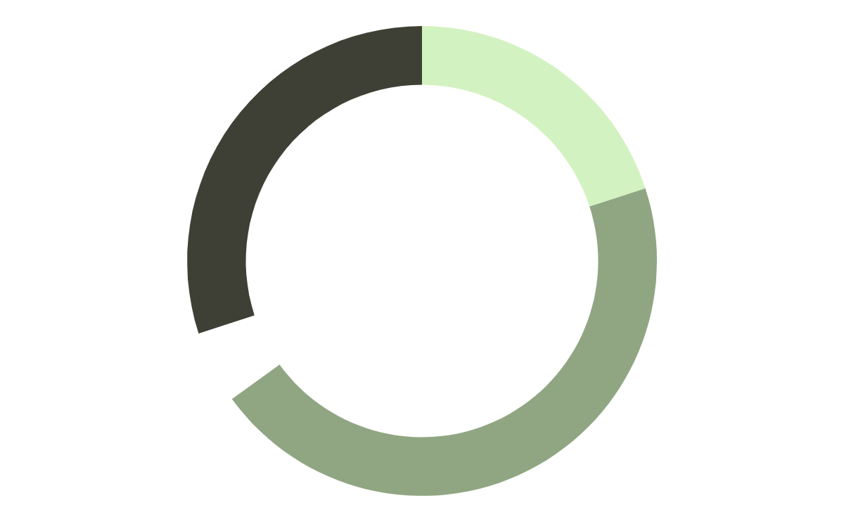
Model Text
3. Use
I am compostable.
1. Introduce yourself
Hello! I’m Dip the Diaper.
4. Why choose me?
2. Material
I don’t harm the environment.
I am made of corn starch.
Use “Chatterpix” to create a video.
https://www.duckduckmoose.com/educational-iphone-itouch-apps-for-kids/chatterpixkids/
Sample video:
Notes:
The teachers asks the students to use the model text to write about their bio-based product or resource.

Slide 20
Session 2
Eco Schools & Bioeconomy

Slide 21
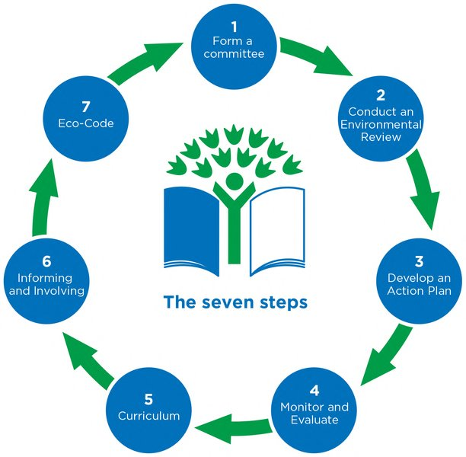
Eco schools & the 7-step methodology
Can you find the connections between the first session and the seven steps of ECO Schools?
https://www.ecoschools.global/seven-steps-methodology
Notes:
The teacher introduces the topic of the day, namely the 7-step methodology of ECO Schools. S/he explains that the students will try to use specific steps of the 7-step circle to disseminate the knowledge they acquired through session 1 related to the concept of Bioeconomy. The teacher uses a video to introduce them to the students.

Slide 22
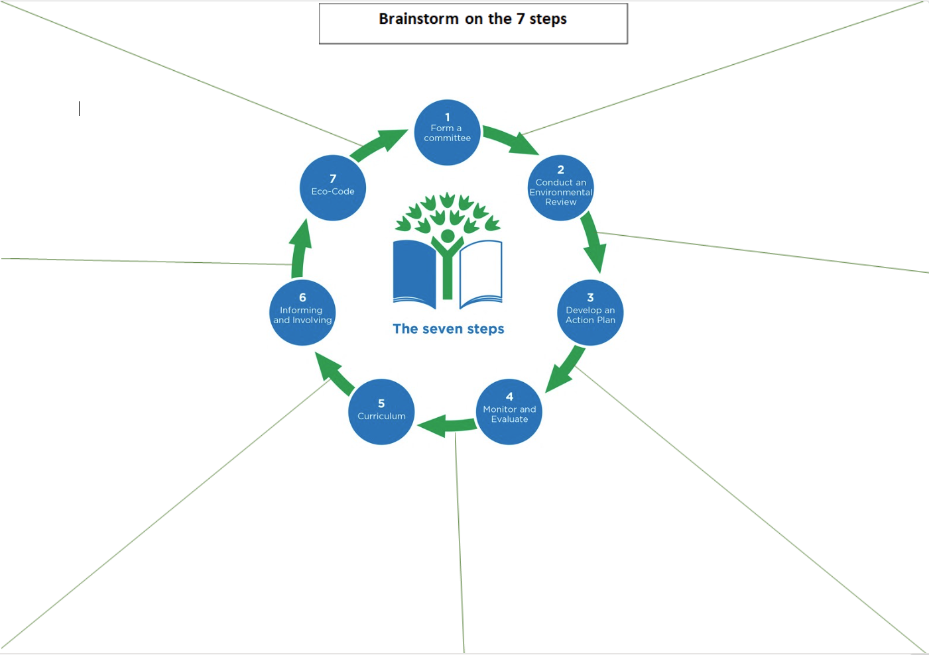
Brainstorm
How can we disseminate the results of our research on bioeconomy?
Should we use the videos we created?
How can we take action at school?
Let’s vote on the best ideas and delegate roles and responsibilities.
e.g We can create a board game with questions from the :What is Bioeconomy?” book and find pawns from natural material they can collect rom the nearby forest.
Ideas:
1. Write a song on bioeconomy
2. Create an acronym and make a fun poster/collage
e.g We can make a presentation with the results and our “chatterpix” videos and present it to the whole school community (classmates, teachers, parents) to celebrate the world Environmental Day.
Ideas:
1. Make a presentation with the Chatterpix images
2. Organise a school theatrical play with the biobased products being the characters
Notes:
The teacher explains that the focus of the session will be on two steps, the Dissemination Stage and the creation of an ECO-CODE. The students work in teams and brainstorm on the ways they can use to disseminate their knowledge using the videos they created. They also propose ways the whole school can use to take action. They vote on the best ideas and write them down. They delegate roles and responsibilities. (Brainstorm map). To facilitate the process try to answer the questions above

Slide 23
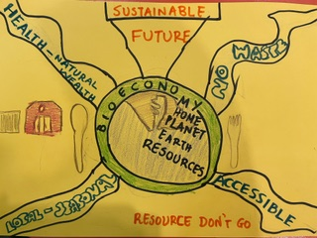
Examples of Eco - Code on Bioeconomy
Song / Poem
Acronym
BIOECONOMY:
B – Biodegradable
I - Innovation
O – Organic
E - Environmental
C - Conservation
O - Opportunity
N - Natural
O - Optimization
M - Management
Y - Yield
Bioeconomy is cool!
It’s an amazing tool
To fight the climate change
And have our planet on stage.
Nikiforos Haskos, Grade 6 student at
Athens College Elementary school
Poster
We can create a poster and put it on the bulletin board at the school entrance.
We can use an acronym of Bioeconomy at school to .
We can write a song / add or change verses of a song with a familiar tune
Notes:
The teachers shows the students samples of ECO-CODES on Bioeconomy. The students create their ECO –CODE of Bioeconomy at school and present it to the whole school community. They also come up with a plan to organise a Bioeconomy Day at school to inform students, parents and teachers about the benefits of bioeconomy (Eco code options worksheet)

Slide 24
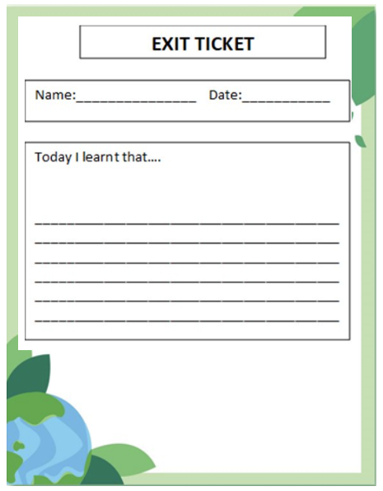
ASSESSMENT AND REFLECTION
The students reflect on what they learnt and fill in the last part of the KWL chart
The students assess their knowledge through the interactive games
The students fill in the EXIT TICKET: Write the most impressive thing you learnt about bioeconomy
. https://wordwall.net/resource/71151472
https://create.kahoot.it/details/5d109e00-bfd8-42ff-8f04-71da275f0750
Notes:
The teacher asks the students to reflect on what they learnt during the lesson. S/he encourages them to play an online game. (quantitative)
https://wordwall.net/resource/71151472
https://create.kahoot.it/details/5d109e00-bfd8-42ff-8f04-71da275f0750
The teacher asks the students to write an exit ticket as they leave the class answering the question “What makes bioeconomy a good option for a sustainable future?” or “Write the most impressive thing you learnt about bioeconomy” .

Slide 25
REFLECTION – If I were to do the Bioeconomy Project again…
Reflection for students
Reflection for Teachers
Notes:
The students reflect on the 7-step methodology and the process they followed by answering the question “If you were to do the Bioeconomy project again, what would you keep and what would you leave out?” filling out the “Three checks – One cross” handout with three things they would like to experience again and one that was not particularly interesting or helpful. The lesson ends by emphasizing the role of individuals and communities in building a healthier planet.
The teachers also fill in the “Three Checks and a Cross” handout by answering the question “Choose two things you enjoyed and feel confident teaching again and one that was too difficult to teach or not particularly interesting or helpful.

Slide 26
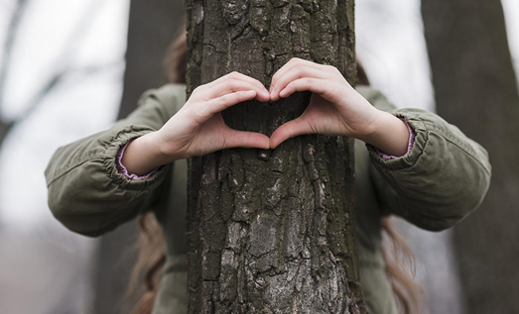
References
1. What is Bioeconomy? Book
2. Pictures
https://encryptedtbn0.gstatic.com/images?q=tbn:ANd9GcSrt9DMrbEWqSp4WHHU8XxSs5WkkYFRwEMP3g&s
https://encrypted-tbn0.gstatic.com/images?q=tbn:ANd9GcSdUr08fOClEJRdUhPxra0em1LI3NY24WW2QQ&s
https://encrypted-tbn0.gstatic.com/images?q=tbn:ANd9GcTStyEZKz0mjyyLwZT68znKA_yB0OPwgCWssQ&s
https://encrypted-tbn0.gstatic.com/images?q=tbn:ANd9GcTStyEZKz0mjyyLwZT68znKA_yB0OPwgCWssQ&s
https://textiletechsource.com/wp-content/uploads/sites/23/2023/07/Adidas-3D-printed-Futurecraft-4DFWD-sole-features-Carbons-new-partially-bio-based-resin.-Courtesy-adidas_ALT.jpg
https://target.scene7.com/is/image/Target/GUEST_7fc009bb-a54f-467f-81fe-881b477c1884?wid=488&hei=488&fmt=pjpeg

Slide 27
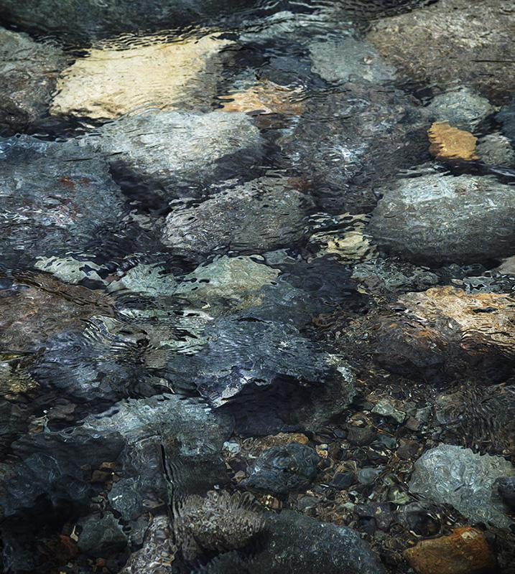
Thanks!
Do you have any questions?
Contact us in:
[insert your e-mail here]​ [insert your school/organization here]
Please keep this slide for the attribution

