Slide 1
Training materials
STEP 1: FORM AN ECO COMMITTEE
M. Giannakopoulou

Slide 2
What is an Eco Committee?
It is a group of people who are the driving force behind the Eco-Schools process and will represent the ideas of the whole school.
https://www.ecoschools.global/seven-steps-methodology

Slide 3
Who is Involved?
An Eco Committee is student-led
Students are on the spotlight so they are:
Undertaking Leadership Roles (chairperson, secretary, coordinators, members)
Making Decisions on the goals strategies and actions that need to be taken for an environmental problem to be solved
Taking Initiative and Showing Creativity to promote environmental awareness and sustainability.

Slide 4
Who is involved?
Students are on the spotlight so they are:
Collaborating with teachers, parents, staff, and invited experts for guidance or support.
Feeling Empowered and Responsibile as they account for the results of their actions
Having a Unique Educational Experience as they are learning about environmental issues, and develop their thinking and problem-solving skills by implementing real-life solutions.
A Strong Peer Influence as they may inspire a broader student community to take action

Slide 5
Who else is involved?
An Eco Committee should include: Students/Teachers/The Principal/Non-Teaching Staff (e.g. Secretary, Caretaker, Cleaner)/Parents/Members of the Board of Management/interested and relevant members of the wider community
It should include students from different grade levels, backgrounds, and interests to provide a more democratic perspective. Teachers and staff members should act as advisors or mentors, providing guidance and support.

Slide 6
What does an Eco Committee do?
They make sure that the seven steps of the Eco schools programme are followed so they assume various roles in the process.
They identify a problem at school, suggest possible solutions, choose the best one, implement it and monitor whether the problem is solved. Then, they ensure that the entire school knows about Eco-Schools action plan and will receive regular updates
They meet regularly to discuss environmental and social actions for the school. They can meet as a whole or separate their tasks and adjust their meeting time accordingly. The meetings can be online or organized at a specific time during the school hours and they can be open to public

Slide 7
Putting Theory Into Practice – Forming a Committee
Waste management has always been a hotly-debated issue at schools and one of the things that annoys students. Therefore the introduction of bioeconomy and the solutions it offers can start from there.
Students can use the traditional methods of conversations and meetings to tackle with it or even use social media to recruit members for the committee. Especially for a committee formed to work on a bioeconomy challenge, you can share your thoughts and ask how the rest of the people in your chat group feel.
e.g Is there anyone else who is really annoyed by the amount of waste and litter in our school?
I am also annoyed, but what can we do?
Why don’t we form an ECO-Committee? We can ask our teachers to help us!
I’m sure we can do something. Have you heard about Bioeconomy and the solutions it offers?
Yes, I am! I know what you mean!
Let’s talk about it during the class assembly!

Slide 8
Step 1 - Forming a Committee - Members
The Eco Commitee can create an online poster (e.g with Canvas) to invite people to join the first committee meetings regarding the waste management at school. In this first meeting, the students can also vote on the representatives each class will have on the Eco Committee. More stakeholders (teachers, parents, the principal, the cleaners, the canteen owner etc) should be invited to join the meeting during which the Eco committee is formed .

Slide 9
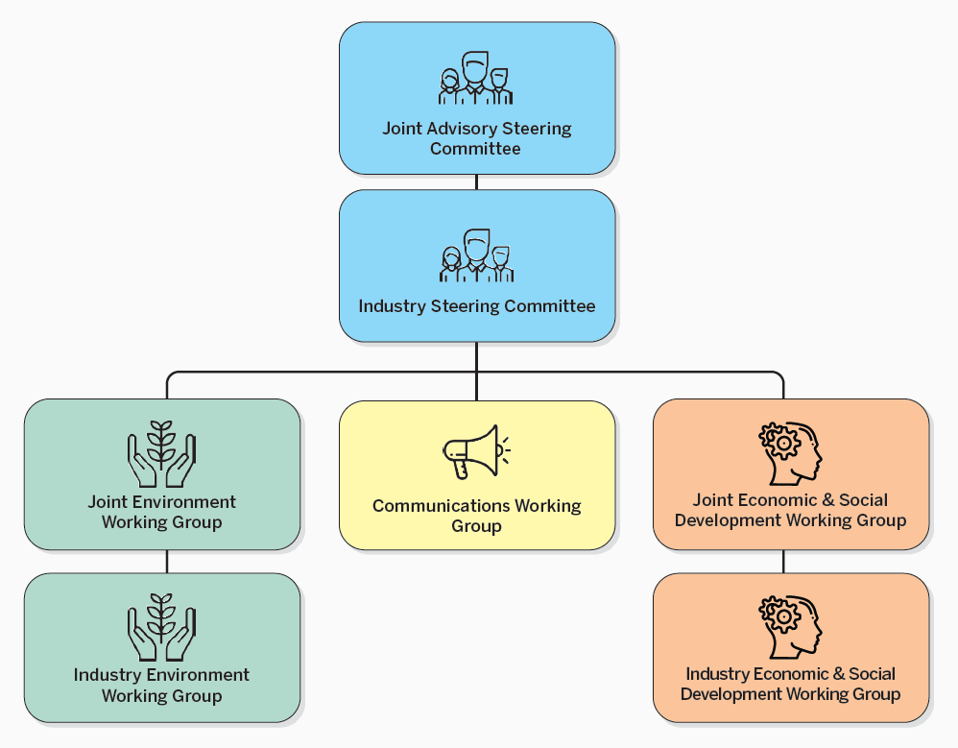
Bioeconomy and the Eco Committee
CASE STUDY:
The Eco Committee of an Elementary school expresses a concern about the significant amounts of waste, including food scraps, paper, and plastic the school generates.
They form the committee by recruiting students from all grades.
They split the Eco committee into sub-groups who can work on a number of solutions since there is a variety of methods used to tackle with the problem of waste at schools.

Slide 10
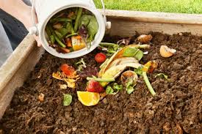
Bioeconomy and the Eco Committee
The first subgroup can introduce composting programs to manage organic waste, by turning food scraps and garden waste into compost for the school gardens.
The committee can decide on the people who will be involved and the course of actions that will be necessary. In this case, the committee will need help from the cafeteria staff so that they can collect the info they need regarding the amount of food that is wasted.
Then they can inform the students about the benefits of composting (with posters, speeches or short presentations in classes).

Slide 11
Bioeconomy and the Eco Committee
After informing the students, the Eco committee needs to monitor and evaluate the course of actions. Is the food waste less? Have the students’ attitudes towards food waste changed?
Then, the committee informs the wider community about the results. They may send a newsletter to the parents and the city council with the amounts of compost the produced as a school unit and the benefits of it.

Slide 12
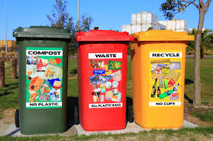
Bioeconomy and the Eco Committee
The second subgroup can introduce recycling programs to reduce plastic and paper waste.
The Eco Committee can take the initiative to collect the waste for two days and present the way we group our school’s waste and dispose them in the recycling bins depending on the material they’re made of.

Slide 13
Bioeconomy and the Eco Committee
Then, they can inform the students about the benefits of recycling at school and inspire them to form smaller groups of volunteers who will contact recycling companies and find the better offer for the school’s recyclable materials. Instead of money, the company could provide the school with recycled paper and biobased school supplies.
The Eco Committee will monitor and evaluate the financial and educational benefits of the specific project and write an article in the school newspaper promoting it as a good practice.

Slide 14
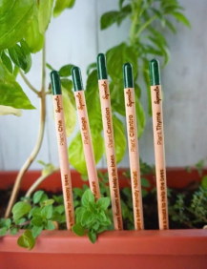
Bioeconomy and the Eco Committee
The third group can promote the use of biodegradable materials in areas such as the school stationery or the food packaging.
The Eco Committee can encourage the students to use bio Snack boxes or bio bags made of fabric. To do that, they can use presentations and material from the book “What’s Bioeconomy ?”, the first flap book about bioeconomy for kids with Alistar Illustration which is produced by BIOVOICES European Project. They can also make the biobased products come alive through Chatterpix which will be more interestring to the younger students.
https://youtube.com/shorts/DCCqACRKFEc?feature=share

Slide 15
Bioeconomy and the Eco Committee
The Eco Committee can also raise funds from selling the compost they produce so that they buy pencils made of bamboo stick and notebooks made of animal poo.
Finally, the Eco Committee need to assess and monitor the course of actions and inform the general public about the initiative by making it public.
If we compare an environmental school project with a concert,
the Eco Committee is the conductor of it who takes the initiative to
organise it, chooses the musicians, the instruments they will play, the order of the songs and evaluates it at the end by identifying the strong points and the ones that need improvement. And if the concert is a hit, then articles and news reports will be made to make the impact even greater.

Slide 16
Extra tips
The Eco Committee can also do the following to facilitate the communication among the members and spread the word faster
They can keep minutes during the meetings and upload them on a specific site/ space at the school’s platform created for the ECO School committee. The students/teachers/parents should have access to them. Then the students can interact through the platform and send their feedback regarding the progress of the actions. They can even make suggestions for a change if the initial plan doesn’t work.

Slide 17
Extra Tips
They can send the whole school community an online monthly newsletter with the course of actions taken on waste management and through that they can share a tip on bioeconomy at school or at home.
eg Goal of the week at home: Zero Food waste – We compost the fruit and vegetable peels
https://www.canva.com/design/DAGGpLqF0pU/7f8liLOGmDFAeWbHcQaDww/edit?utm_content=DAGGpLqF0pU&utm_campaign=designshare&utm_medium=link2&utm_source=sharebutton

Slide 18
Educational Resources
https://www.ecoschools.global/seven-steps-methodology
What’s Bioeconomy? Book
https://projects.research-and-innovation.ec.europa.eu/en/research-area/industrial-research-and-innovation/eu-valorisation-policy/knowledge-valorisation-platform/repository/whats-bioeconomy-book-kids

